Slide 1
Human Activity Recognition from Accelerometer Data
Anthimos Kalosidis
Garo Garabetian
Department of Mathematics, AUTh

Slide 2
Workflow Outline
Data pre-processing
Feature Extraction
Model Construction / Evaluation
Model Comparison / Selection
Testing on Independent Data / Activity Grouping
Conclusions

Slide 3
Raw Data & Structure
Selected “Left Pocket” as our data set
Ten (10) participants, each doing seven (7) activities
About 3-4 minutes per activity
Sampling rate: 50 samples / second (Hz)
Notes:
Brief outline of the raw data. Bridge: Now we shall proceed by showcasing how we handled the given data (preprocessing) να αποφευχθούν συνεχώς οι ίδιες λέξεις, ΟΧΙ όμως όταν πρόκειται για ορολογία

Slide 4
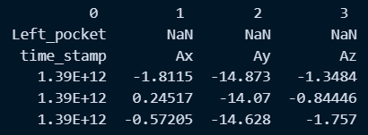

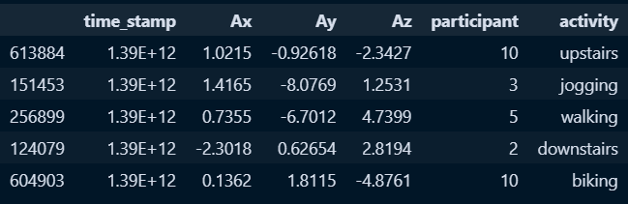
Data Preprocessing
Extract only essential columns (Ax, Ay, Az, activity, participant)
Combine all participants and compute acceleration magnitude

Slide 5
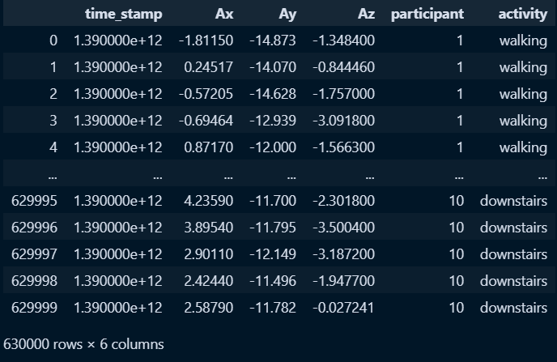
Data Cleanup
Handle possible outliers in data
None found (!)
Check for missing values
Data shape:

Slide 6
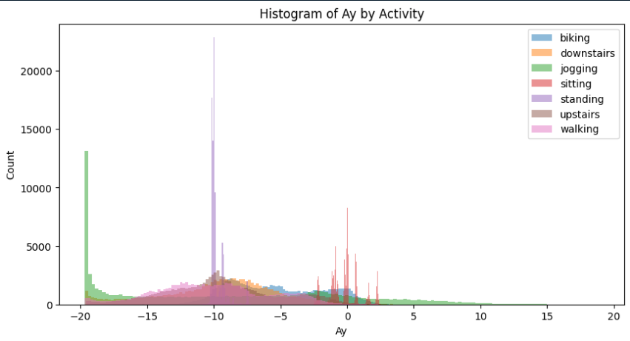
Data Exploration
Different axes highlight different activities (check Biking here)
Notes:
Present a histogram (i chose Ay because it is clear to see biking for example). Note the patterns that are already arising (check Ay ~= 10 m/sec^2 for biking activity , or Ay hovering around 0 for sitting). Also histograms for Ax, Az, in which we can also observe similar patterns. (we elect to not show everything so as not to repeat ourselves)

Slide 7
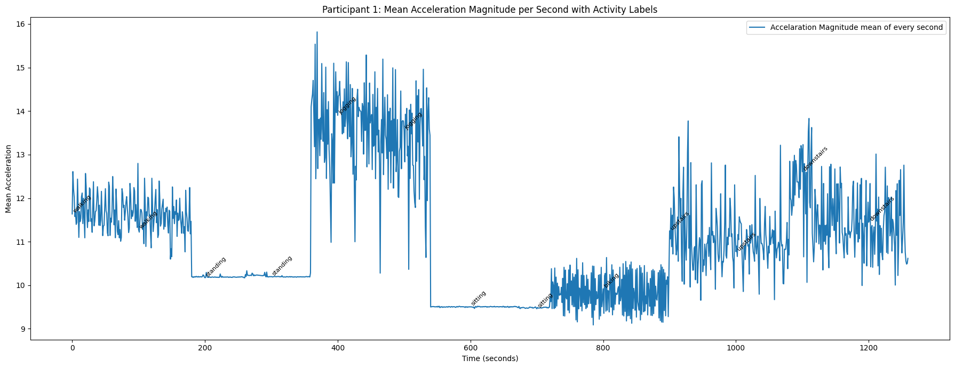
Signal Visualization
Trend plot for participant 1
Notes:
Explain each peak and low (keep in mind that labels might not be visible to the viewer, so explain what we’re seeing here). Finally, bridge this final preprocessing slide to the next (first feature_extraction slide)

Slide 8
Creating Sliding Window
Window size: 0 sec (1000 samples)
Highly overlapping
Sliding every second (50 samples)
Label each window with the majority activity
Features per window:
Mean value
Standard Deviation
Skewness
Max Value
Min Value
Range (Max - Min)

Slide 9
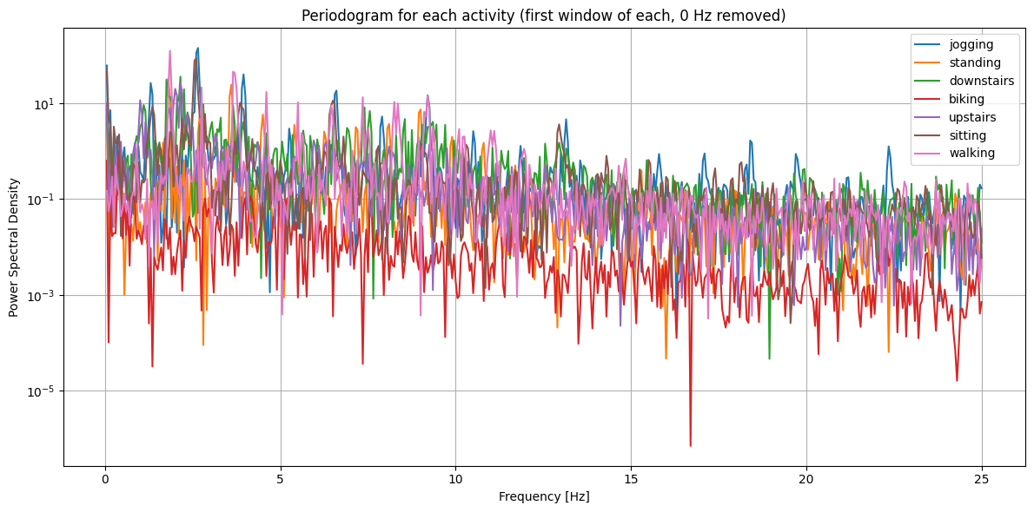
Periodogram
Activities have distinctive spectral “fingerprints”

Slide 10
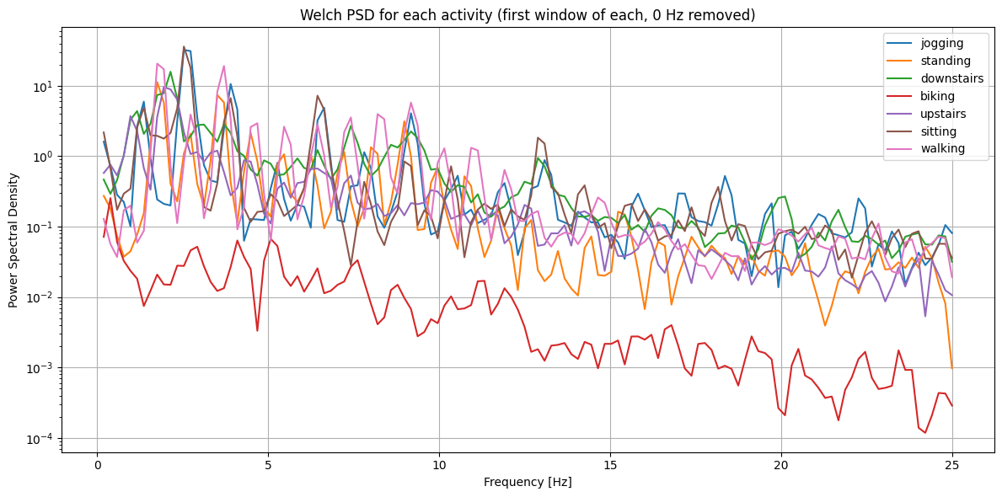
welch eite tha mpei apla me ta prohgoymena sthn 8h diafaneia, eite tha ginei se ayth th diafaneia kai meta to PSD. vale th theoria pou exeis sto arxeio
Notes:
Again, bridge to LOSO modeling (using these features we move on to cross-validation steps ….)

Slide 11

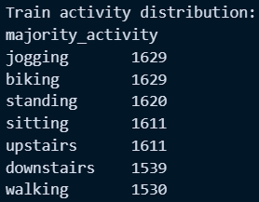
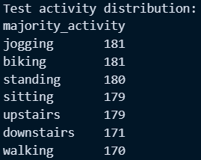
LOSO cross-validation
Train on N-1 subjects, test on the remaining
Assess generalization to unseen people / pockets

Slide 12
Support Vector Machine (SVM) Results
Mean LOSO SVM Accuracy: ~0.73
Optimal Hyperparameters:
Kernel: Poly
C = 0.1
γ = 0.01
Employed Grid Search with 3-fold cross-validation for faster results

Slide 13
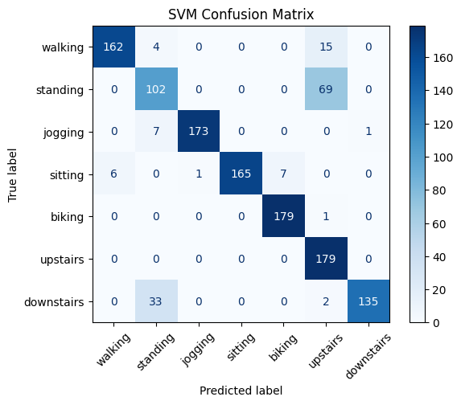
Support Vector Machine (SVM) Results
Standing
Upstairs
Downstairs
are more often confused

Slide 14
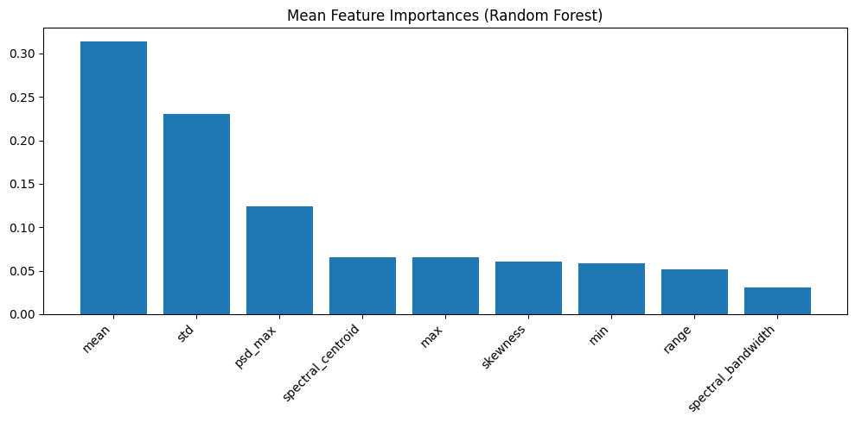
Random Forest Classifier Results
Mean LOSO RF Accuracy: ~0.78
No significant optimization achieved with hyperparameter tuning

Slide 15
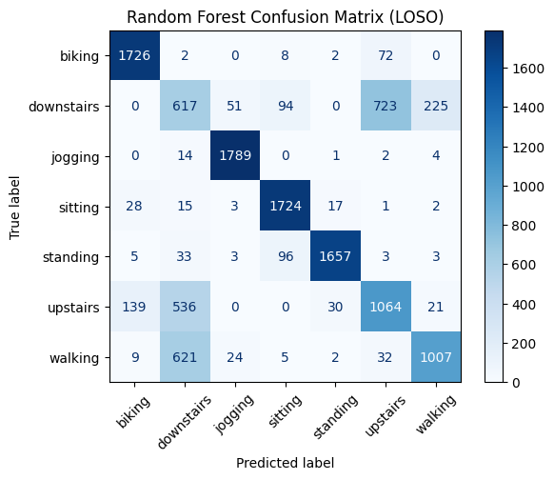
Random Forest Classifier Results
Upstairs - Downstairs
consistently confused
Note: Walking

Slide 16
MLP (Neural Network) Results
Very poor results without parameter optimization (2 hidden layers, momentum = 0.9)
Optimal Hyperparameters:
Activation function: tanh
Regularization term (alpha) = 0.0001
2 hidden layers, 30 neurons each
Momentum = 0.95
Weight Opt Solver = Stochastic Gradient Descent (SGD)
Number of Epochs = 500
Best LOSO Test Accuracy: ~0.77

Slide 17
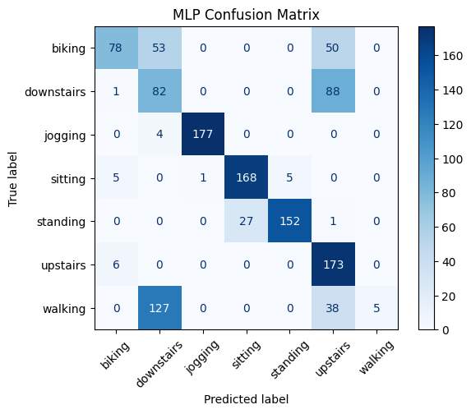
MLP (Neural Network) Results
CHANGE THIS CONFUSION MATRIX, ITS FOR WRONG MLP

Slide 18
Raw Data and Structure
Selected “Left Pocket” as our data set
Extract selected data for each participant

Slide 19
Raw Data and Structure
Selected “Left Pocket” as our data set
Extract selected data for each participant

Slide 20
Raw Data and Structure
Selected “Left Pocket” as our data set
Extract selected data for each participant

Slide 21
References:
Ascher, U.M. and Petzold, L.R. (1998) Computer Methods for Ordinary Differential Equations and Differential-Algebraic Equations. Siam.
Bathe, K.-J. (2006) Finite Element Procedures. Englewood Cliffs, N.J: Prentice Hall.
Belytschko, T. and Hughes, T.J.R. (1986) Computational methods for transient analysis. Amsterdam: North-Holland.
Dahlquist, G. (1956) ‘Convergence and stability in the numerical integration of ordinary differential equations’, MATHEMATICA SCANDINAVICA, 4, p. 33.
Gear, G.W. (1971) Numerical Initial Value Problems in Ordinary Differential Equations. Prentice-Hall.
Geradin, M. (2015) Mechanical vibrations theory and application to structural dynamics. Newark: John Wiley & Sons, Incorporated.

Slide 22
Hilber, H.M. and Hughes, T.J. (1978) ‘Collocation, dissipation and [overshoot] for time integration schemes in structural dynamics’, Earthquake Engineering &amp; Structural Dynamics, 6(1), pp. 99–117.
Hilber, H.M., Hughes, T.J. and Taylor, R.L. (1977) ‘Improved numerical dissipation for time integration algorithms in structural dynamics’, Earthquake Engineering &amp; Structural Dynamics, 5(3), pp. 283–292.
Kurdila, A.J. and Craig, R.R. (2013) Fundamentals of Structural Dynamics. Wiley.
Newmark, N.M. (1959) ‘A method of computation for Structural Dynamics’, Journal of the Engineering Mechanics Division, 85(3), pp. 67–94.
Nickell, R.E. (1971) ‘On the stability of approximation operators in problems of structural dynamics’, International Journal of Solids and Structures, 7(3), pp. 301–319.
Wood, W.L. (1990) Practical Time-Stepping Schemes. Oxford University Press.

